Slide 1
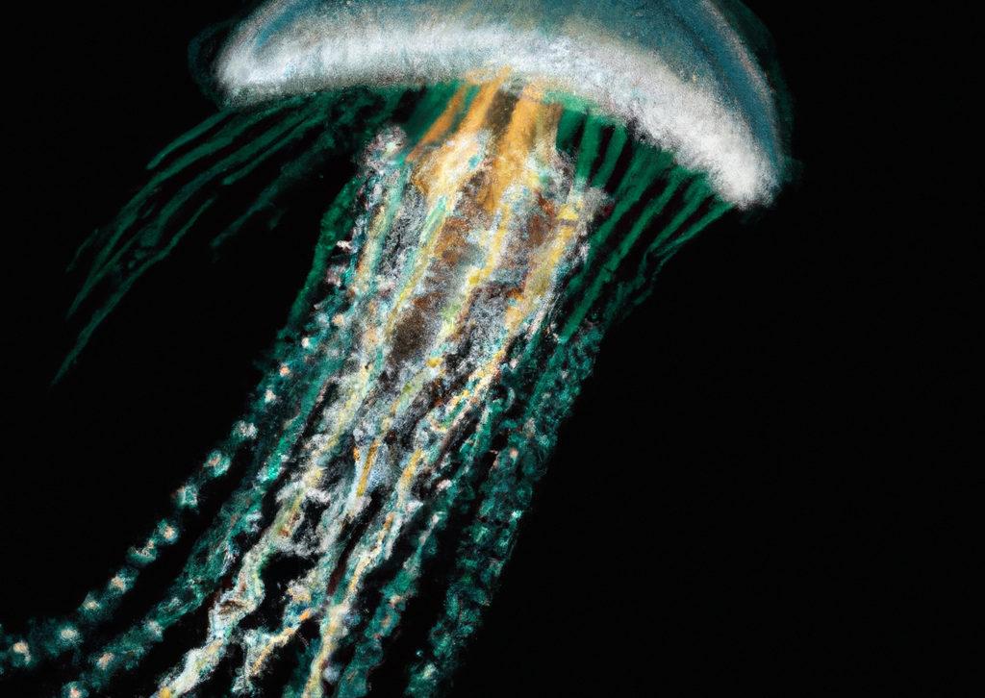
"Exploring the Fascinating World of Jellyfish"
Jellyfish and sea jellies are informal names given to the medusa stage of certain gelatinous creatures
Belonging to the subphylum Medusozoa, which is a significant part of the Cnidaria phylum
Predominantly marine animals with umbrella-shaped bodies and trailing tentacles
They propel themselves by pulsating their bells
Tentacles equipped with stinging cells to capture prey and defend against predators
Complex life cycle with the medusa stage being the sexual phase
Planula larvae disperse widely and then settle into a sedentary polyp stage before reaching sexual maturity

Slide 2
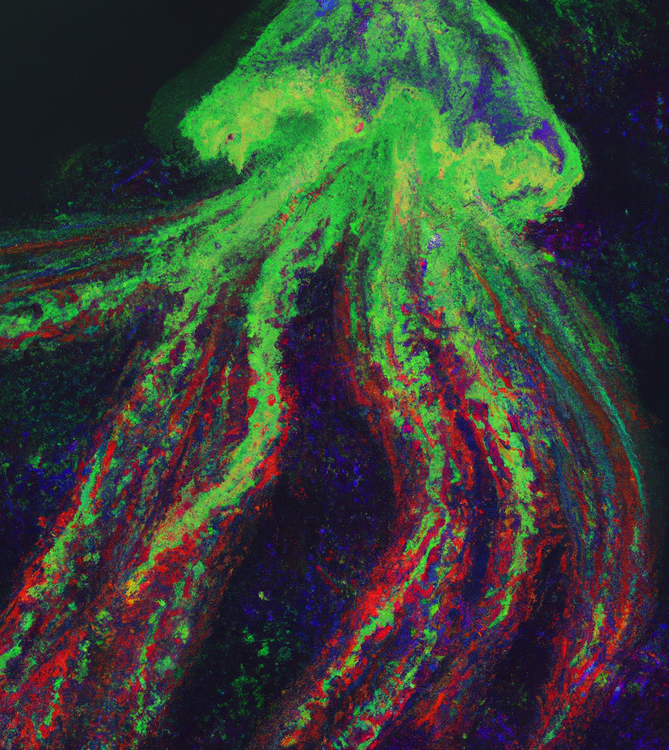
"The Diverse and Ancient World of Jellyfish"
Jellyfish can be found in various locations worldwide
Scyphozoans are exclusively marine, while there are freshwater hydrozoans that resemble them
Most species of jellyfish have a rapid growth rate, reaching maturity within a few months
Polyp stage is attached to the seabed and can be much longer-lived
Jellyfish have been around for at least 500 million years, making them the oldest known multi-organ animal group

Slide 3
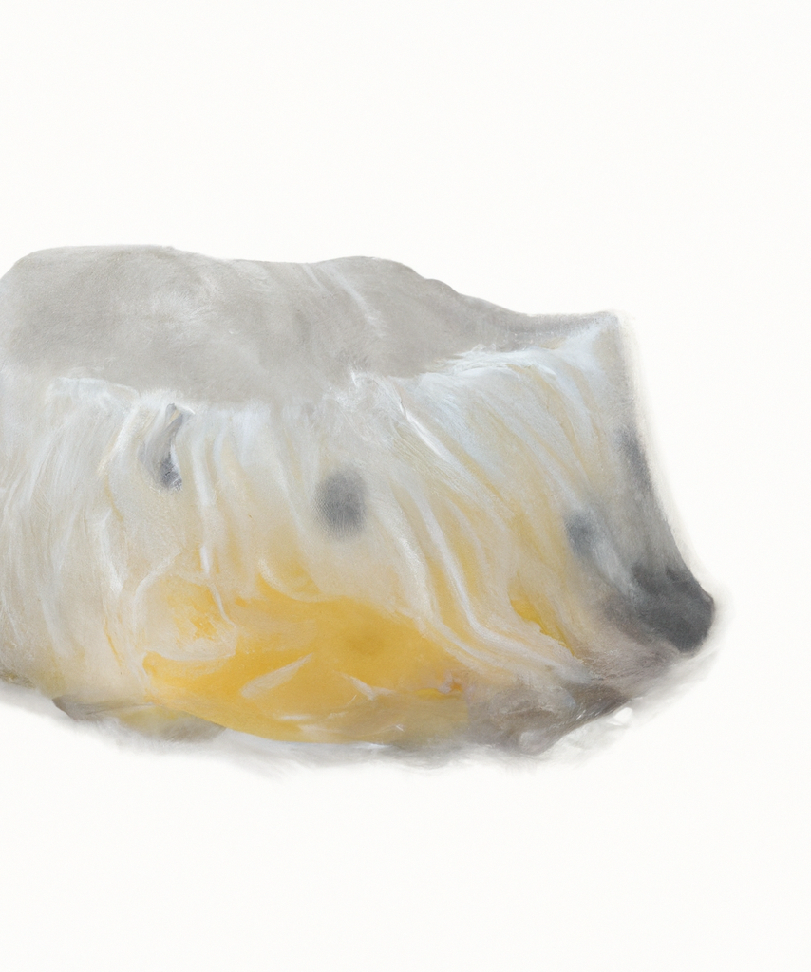
The Perfect Food: The Nutritional Benefits of Eating Jellyfish
Jellyfish as a delicacy in certain cultures
Salting and pressing species from the Rhizostomae order to remove excess water
Described as a sustainable and protein-rich "perfect food"
Low caloric content

